Slide 1
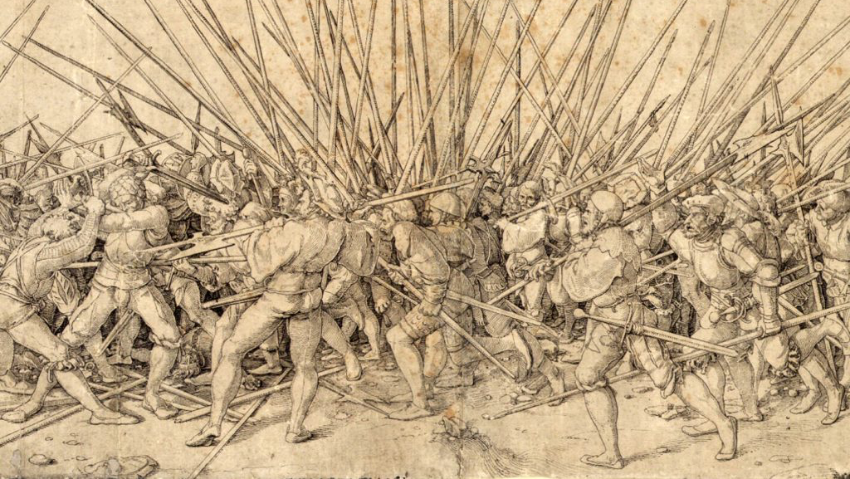
Did God Command Genocide? The Problem of O.T. Violence
Travis Dickinson, PhD
www.travisdickinson.com
@travdickinson

Slide 2
www.travisdickinson.com
FREE book for signing up for my newsletter!!

Slide 3
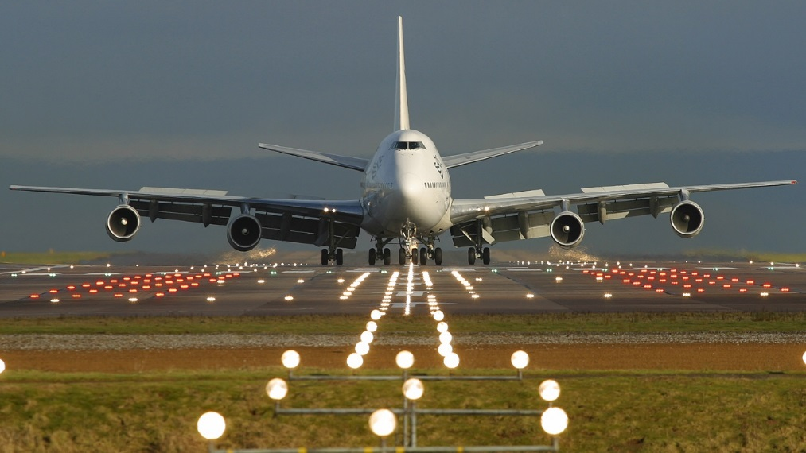
What do you do when you face a difficult objection?
Notes:
How grounded are we in our Christian faith. There are a few difficult objections but there are very many powerful reasons
We are going to look at a difficult objection. We may not solve it.

Slide 4
God of the Old Testament
There are things in the Bible I don’t like.
But being unpleasant is not wrong or morally evil.

Slide 5
“The God of the Old Testament is arguably the most unpleasant character in all fiction: jealous and proud of it; a petty, unjust, unforgiving control-freak; a vindictive, bloodthirsty ethnic cleanser; a misogynistic, homophobic, racist, infanticidal, genocidal, filicidal, pestilential, megalomaniacal, sadomasochistic, capriciously malevolent bully.“
~Richard Dawkins
Notes:
He’s basically saying that the God of the OT is extremely evil.

Slide 6
“The universe we observe has precisely the properties we should expect if there is, at bottom, no design, no purpose, no evil, no good, nothing but blind, pitiless indifference.”
~Richard Dawkins
Notes:
It’s worth mentioning that atheists will also say something like this.

Slide 7
“The God of the Old Testament is arguably the most unpleasant character in all fiction: jealous and proud of it; a petty, unjust, unforgiving control-freak; a vindictive, bloodthirsty ethnic cleanser; a misogynistic, homophobic, racist, infanticidal, genocidal, filicidal, pestilential, megalomaniacal, sadomasochistic, capriciously malevolent bully.“
~Richard Dawkins

Slide 8
“The God of the Old Testament is arguably the most unpleasant character in all fiction: jealous and proud of it; a petty, unjust, unforgiving control-freak; a vindictive, bloodthirsty ethnic cleanser; a misogynistic, homophobic, racist, infanticidal, genocidal, filicidal, pestilential, megalomaniacal, sadomasochistic, capriciously malevolent bully.“
~Richard Dawkins

Slide 9
Did God command genocide?
Fact: There are a variety of statements in the O.T. that look to be commands for Israel to wipe out whole people groups.
“Herem” = to utterly destroy
Notes:
The word genocide is obviously loaded.

Slide 10
Did God command genocide?
“…when the Lord your God delivers them over to you and you defeat them, you must completely destroy them. (Deut. 7:2)
“…you shall save alive nothing that breathes, but you shall utterly destroy them…” (Deut. 20:16-17a)
So Joshua conquered the whole region…with all their kings, leaving no survivors. He completely destroyed every living being…conquered everyone from Kadesh-barnea to Gaza, and all the land of Goshen as far as Gibeon. (Josh. 10:40-41)
“Now go, attack the Amalekites and totally destroy everything that belongs to them. Do not spare them; put to death men and women, children and infants, cattle and sheep, camels and donkeys.” (1 Sam 15:2-3)

Slide 11
Did God command genocide?
“¹When the Lord your God brings you into the land you are entering to possess, and he drives out many nations before you…² and when the Lord your God delivers them over to you and you defeat them, you must completely destroy them. Make no treaty with them and show them no mercy. ³ You must not intermarry with them, and you must not give your daughters to their sons or take their daughters for your sons…” (Deut. 7:1-3)
Notes:
Only in the cities of these peoples that the Lord your God is giving you as an inheritance, you shall not leave alive anything that breathes. But you shall utterly destroy them, the Hittite and the Amorite, the Canaanite and the Perizzite, the Hivite and the Jebusite, as the Lord your God has commanded you, so that they may not teach you to do according to all their detestable things which they have done for their gods, so that you would sin against the Lord your God. (Deut. 20.16-18)
Now go, attack the Amalekites and totally destroy everything that belongs to them. Do not spare them; put to death men and women, children and infants, cattle and sheep, camels and donkeys.’” (1 Sam 15:2-3)

Slide 12
Did God command genocide?
“¹When the Lord your God brings you into the land you are entering to possess, and he drives out many nations before you…² and when the Lord your God delivers them over to you and you defeat them, you must completely destroy them. Make no treaty with them and show them no mercy. ³ You must not intermarry with them, and you must not give your daughters to their sons or take their daughters for your sons…” (Deut. 7:1-3)
Notes:
When the Lord your God brings you into the land where you are entering to possess it, and clears away many nations before you…you shall utterly destroy them. You shall make no covenant with them and show no favor to them. Furthermore, you shall not intermarry with them…. For they will turn your sons away from following Me to serve other gods. Then the anger of the Lord will be kindled against you and He will quickly destroy you. But thus you shall do to them: You shall tear down their altars, and smash their sacred pillars, and hew down their Asherim, and burn their graven images with fire. (Deut. 7:1-5)³
Only in the cities of these peoples that the Lord your God is giving you as an inheritance, you shall not leave alive anything that breathes. But you shall utterly destroy them, the Hittite and the Amorite, the Canaanite and the Perizzite, the Hivite and the Jebusite, as the Lord your God has commanded you, so that they may not teach you to do according to all their detestable things which they have done for their gods, so that you would sin against the Lord your God. (Deut. 20.16-18)
Now go, attack the Amalekites and totally destroy everything that belongs to them. Do not spare them; put to death men and women, children and infants, cattle and sheep, camels and donkeys.’” (1 Sam 15:2-3)

Slide 13
Did God command genocide?
“¹When the Lord your God brings you into the land you are entering to possess, and he drives out many nations before you…² and when the Lord your God delivers them over to you and you defeat them, you must completely destroy them. Make no treaty with them and show them no mercy. ³ You must not intermarry with them, and you must not give your daughters to their sons or take their daughters for your sons…” (Deut. 7:1-3)
Notes:
When the Lord your God brings you into the land where you are entering to possess it, and clears away many nations before you…you shall utterly destroy them. You shall make no covenant with them and show no favor to them. Furthermore, you shall not intermarry with them…. For they will turn your sons away from following Me to serve other gods. Then the anger of the Lord will be kindled against you and He will quickly destroy you. But thus you shall do to them: You shall tear down their altars, and smash their sacred pillars, and hew down their Asherim, and burn their graven images with fire. (Deut. 7:1-5)³
Only in the cities of these peoples that the Lord your God is giving you as an inheritance, you shall not leave alive anything that breathes. But you shall utterly destroy them, the Hittite and the Amorite, the Canaanite and the Perizzite, the Hivite and the Jebusite, as the Lord your God has commanded you, so that they may not teach you to do according to all their detestable things which they have done for their gods, so that you would sin against the Lord your God. (Deut. 20.16-18)
Now go, attack the Amalekites and totally destroy everything that belongs to them. Do not spare them; put to death men and women, children and infants, cattle and sheep, camels and donkeys.’” (1 Sam 15:2-3)

Slide 14
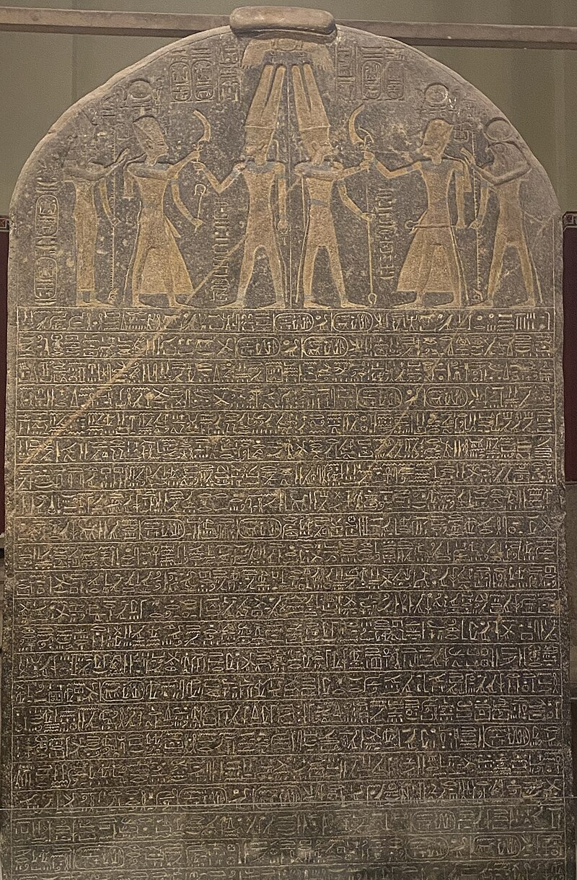
Merneptah Stele
“Israel is laid waste, its seed is no more”
True or false?
Notes:
Pharoah in the 1200s BC who brags about coming against Israel…notice the extreme war rhetoric. Obviously this shouldn’t be taken literally.

Slide 15
Joshua 10:36-39
Describes a “total annihilation” of Hebron and Debir:
37 Joshua “left no survivors. . . . They totally destroyed [Hebron] and everyone in it”
39 “They . . . put them to the sword. Everyone in it, they totally destroyed. They left no survivors. They did to Debir and its king as they had done to . . . Hebron.”
Joshua 15:13-15 describes and even names inhabitants that were still there at both Hebron and Debir.
Notes:
in Joshua 10:36-39, it describes a total annihilation of Hebron and Debir. Joshua “left no survivors. . . . They totally destroyed [Hebron] and everyone in it” (v. 37), and “They . . . put them to the sword. Everyone in it, they totally destroyed. They left no survivors. They did to Debir and its king as they had done to . . . Hebron” (v. 39). Sounds like total annihilation, right? The problem is that Joshua is clear a few chapters later that these towns were not totally annihilated. Joshua 15:13-15 describes and even names inhabitants that were still there at both Hebron and Debir.

Slide 16
Joshua 10:40-41
So Joshua conquered the whole region…with all their kings, leaving no survivors. He completely destroyed every living being [all that breathed]…conquered everyone from Kadesh-barnea to Gaza, and all the land of Goshen as far as Gibeon. (Josh. 10:40-41)
There was none of the Anakim left in the land of the people of Israel. Only in Gaza, in Gath, and in Ashdod did some remain. (Josh. 11:22)

Slide 17
1 Samuel 15:2-3
“Now go, attack the Amalekites and totally destroy everything that belongs to them. Do not spare them; put to death men and women, children and infants, cattle and sheep, camels and donkeys.” (1 Sam 15:2-3)
“He captured King Agag of Amalek alive, but he completely destroyed all the rest of the people with the sword. Saul and the troops spared Agag, and the best of the sheep, goats, cattle, and choice animals, as well as the young rams and the best of everything else.” (1 Sam. 15:8-9a)
Notes:
It appears that Saul has followed the command to wipe the people with just a few exceptions.
Samuel kills Agag.
1 Samuel 27:8

Slide 18
1 Samuel 15:2-3
The Bible seems to say that Saul destroyed all the Amalekites.
But there are many Amalekite’s still around throughout the rest of 1 Samuel and in other parts of the OT.
Even Agog’s line continues…Esther 3:1 identifies Haman as a descendent of Agog.
Notes:
Samuel confronts Saul kills Agag.
David, as king, has to contend with Amalekites numerous times.
¹³ When Samuel came to him, Saul said, “May the Lord bless you. I have carried out the Lord’s instructions.”
¹⁴ Samuel replied, “Then what is this sound of sheep, goats, and cattle I hear?”
¹⁵ Saul answered, “The troops brought them from the Amalekites and spared the best sheep, goats, and cattle in order to offer a sacrifice to the Lord your God, but the rest we destroyed.”
¹⁶ “Stop!” exclaimed Samuel. “Let me tell you what the Lord said to me last night.”
“Tell me,” he replied.
¹⁷ Samuel continued, “Although you once considered yourself unimportant, haven’t you become the leader of the tribes of Israel? The Lord anointed you king over Israel ¹⁸ and then sent you on a mission and said, ‘Go and completely destroy the sinful Amalekites. Fight against them until you have annihilated them.’ ¹⁹ So why didn’t you obey the Lord? Why did you rush on the plunder and do what was evil in the Lord’s sight?”
²⁰ “But I did obey the Lord!” Saul answered.^{[c]} “I went on the mission the Lord gave me: I brought back King Agag of Amalek, and I completely destroyed the Amalekites. ²¹ The troops took sheep, goats, and cattle from the plunder—the best of what was set apart for destruction—to sacrifice to the Lord your God at Gilgal.”

Slide 19
Did God command genocide?
(Or did God command the killing of whole people groups?)
It’s questionable!
There’s a compelling case that all of Israel’s conquest of Canaan were military campaigns with the aim of conquering and driving out….NOT putting all to death.
Notes:
Now we might have an issue with this too. But our question is was it genocide?
Jesus was okay with it.

Slide 20
Genocide?
Could God justly command the killing of people?
Could God justly put people to death himself?
Notes:
in Joshua 10:36-39, it describes a total annihilation of Hebron and Debir. Joshua “left no survivors. . . . They totally destroyed [Hebron] and everyone in it” (v. 37), and “They . . . put them to the sword. Everyone in it, they totally destroyed. They left no survivors. They did to Debir and its king as they had done to . . . Hebron” (v. 39). Sounds like total annihilation, right? The problem is that Joshua is clear a few chapters later that these towns were not totally annihilated. Joshua 15:13-15 describes and even names inhabitants that were still there at both Hebron and Debir.

Slide 21
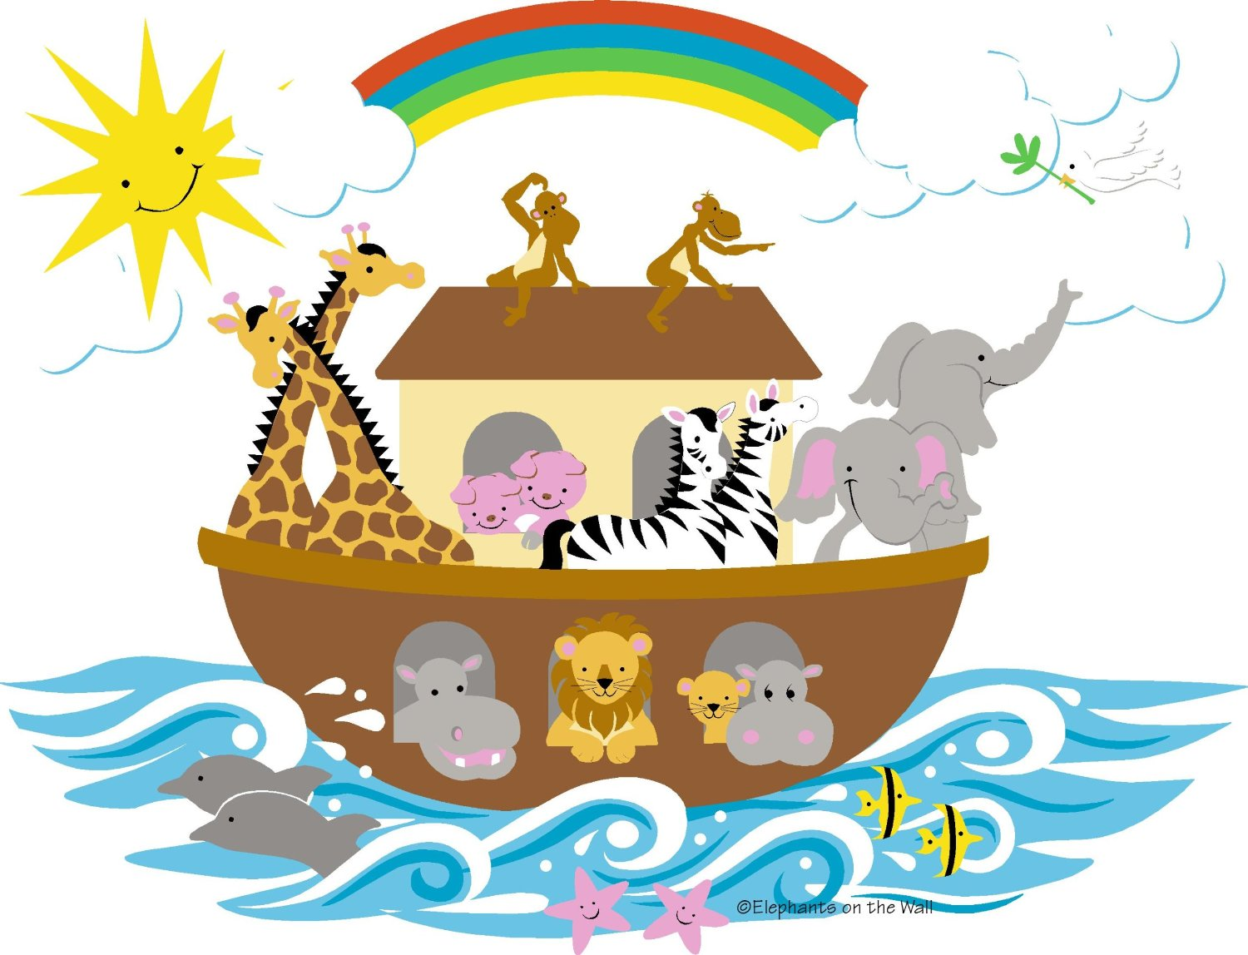
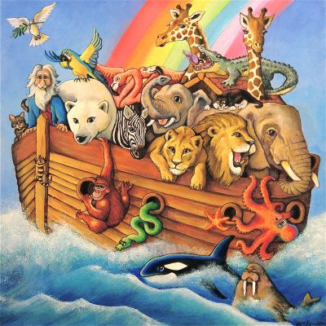
Noah’s Flood
Test case: Noah’s flood (Gen. 6-8)
God wiped out many men, women, children and animals.
Was God justified?

Slide 22
Noah’s Flood
Bad responses:
“God can do evil”…God is essentially good.
“God defines morality”…This would make morality arbitrary.
“God is the author of life”…God must be just.
Notes:
Would God be justified in torturing innocent people for fun?
It’s very Christian to say ”God cannot x”

Slide 23
Moral Questions
How do we know if someone’s action is morally justified or immoral?

Slide 24
Moral Questions
Notes:
It was a dark and stormy night…the masked man stood over her unconscious body. He calculated what he was going to do. There was no question that he was going to do it. The only question was how he would do it. Before him stood an assortment of cold metal instruments, all of them sharp, all of them deadly. He made his selection of an especially sharp and would strike terror in any one who would see it come near. With trained precision he thrust the instrument into her helpless body. Through blood, bones and flesh he cut her.

Slide 25
Moral Questions
Notes:
The moral evaluation of this story changes when we find out this is a surgeon who is acting to save the life of the woman.
He is clearly justified. Not only is he not doing anything morally wrong…he’s doing something that is morally virtuous.

Slide 26
Moral Questions
To judge the moral status of any action, we must know the moral context.
Who’s involved?
What moral authority do they have?
What is the actors' intention in the event?
What has brought about the event?
Notes:
What is the reason for acting

Slide 27
Noah’s Flood
Who is God and what’s his moral authority?
God is love (1 Jn. 4:8)…
…but the biblical God is not only love!!
God is the transcendent creator. (Gen. 1:1; Acts 17:24)
God is also holy. (Lev. 20:26; 1 Peter 1:16)
God is also judge of humanity. (Is. 66:16; Heb. 12:23)
Notes:
Remember the objection is that the biblical conception of God is a capricious and killing in an unjustified way.

Slide 28
Noah’s Flood
What is the moral context?
Judgment for rampant wickedness
Also…
God grieves for the situation (Gen. 6:6).
God saves Noah and his family, and covenants with him.
Notes:
What does it mean for God to grieve? I don’t know, but however this goes, it is not the capricious tyrant.
It’s unpleasant but is it unjust?

Slide 29
Noah’s Flood
Here’s the point:
God, as the transcendent holy judge of humanity, has the moral authority to carry out justice on evildoers.
Notes:
It is not morally wrong for a judge to order an execution in appropriate circumstances nor is it wrong for an executioner to carry out the order.
We get so used to grace that we begin to demand as a matter of justice.

Slide 30
Noah’s Flood
What about the children?
Is God justified in the fact that young children are killed?
All people experience the consequences of the fall
The eternal weight of glory
God has a good plan and knows the future
Notes:
Children are not immune to the effects of the fall. They will die. That’s not evil of God.
2 Cor. 4:17 For momentary, light affliction is producing for us an eternal weight of glory far beyond all comparison,

Slide 31
The Burden of Proof
How could one decide that God has done something evil?
It’s not enough to show that God acts unpleasantly.
One would have to show that God doesn’t have the moral authority to judge evildoers.
This is not an easy burden to shoulder.
Notes:
It would be wrong for you and me to perform these actions.
But that does nothing to show that God is morally wrong in these cases.

Slide 32
God of the Old Testament
The Bible portrays God as transcendent, just and a holy judge.
But he is also merciful, gracious, and always redemptive.
Does this solve all issues?

Slide 33
The Good News of God’s Justice
Mercy and justice come together in the cross!!
Notes:
It is not morally wrong for a judge to order an execution in appropriate circumstances nor is it wrong for an executioner to carry out the order.

