Slide 1
Where is God? The Problem of Divine Hiddenness
Travis Dickinson, PhD
www.travisdickinson.com

Slide 2
www.travisdickinson.com
FREE book for signing up for my newsletter!!

Slide 3
Hiding
Who can spot what’s “hidden” in the following pictures?

Slide 12
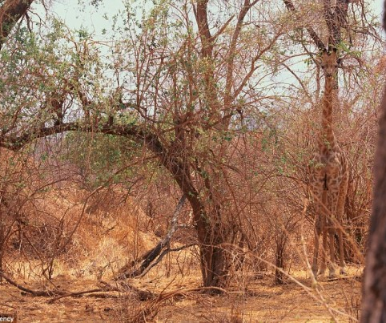
Is God hidden?
My claim: Yes, but he’s hidden in plain view and seeing him takes having the right approach.
Notes:
*We mean throughout the Christian God. This means all good and all powerful and a God who desires relationship with us.
It is a logically valid argument…and so if we don’t like the conclusion we have to reject one or both of the premises.

Slide 13
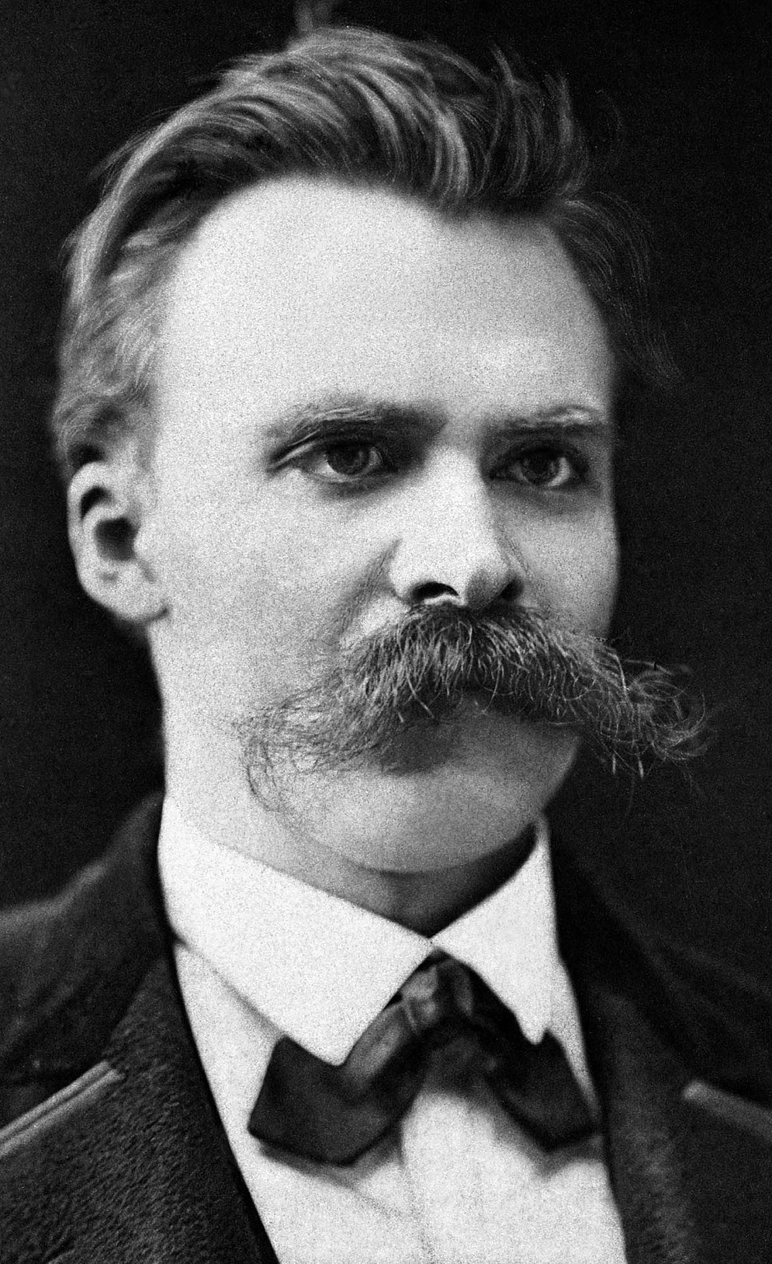
Friedrich Nietzsche
“A god who is all-knowing and all-powerful and who does not even make sure that his creatures understand his intention could that be a god of goodness? Who allows countless doubts and dubieties to persist, for thousands of years, as though the salvation of mankind were unaffected by them,

Slide 14
Friedrich Nietzsche
and who on the other hand holds out the prospect of frightful consequences if any mistake is made as to the nature of the truth? Would he not be a cruel god if he possessed the truth and could behold mankind miserably tormenting itself over the truth?”

Slide 15
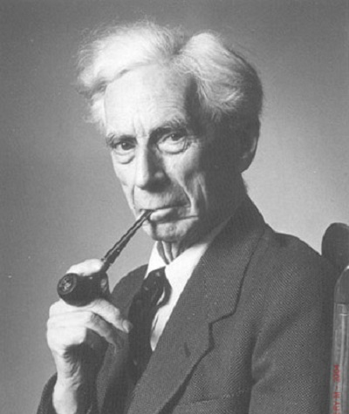
Bertrand Russell
“Not enough evidence, God! Not enough evidence.”
Notes:
What would you say if, upon death, you found yourself face to face with God.
*We mean throughout the Christian God. This means all good and all powerful and a God who desires relationship with us.
It is a logically valid argument…and so if we don’t like the conclusion we have to reject one or both of the premises.

Slide 16
What’s the Problem?
There are times when God seems absent.
Some find the existence of God inconclusive and thereby conclude God does not exist.
The intuition: If God is really there, his existence should be obvious.
Notes:
*We mean throughout the Christian God. This means all good and all powerful and a God who desires relationship with us.
It is a logically valid argument…and so if we don’t like the conclusion we have to reject one or both of the premises.

Slide 17
What’s the Problem?
If God* exists, he is sufficiently obvious.
But God is not sufficiently obvious.
Therefore, God does not exist.
This is the Problem of Divine Hiddenness.
Notes:
*We mean throughout the Christian God. This means all good and all powerful and a God who desires relationship with us.
It is a logically valid argument…and so if we don’t like the conclusion we have to reject one or both of the premises.

Slide 18
Why must God be obvious?
If God is all powerful, he could make his existence obvious.
If God is all good and perfectly loving, he should make his existence obvious.
It would be unloving to hide from someone in their hour of need.
Notes:
This has eternal consequence.
God hides and then punishes people when they don’t believe.

Slide 19
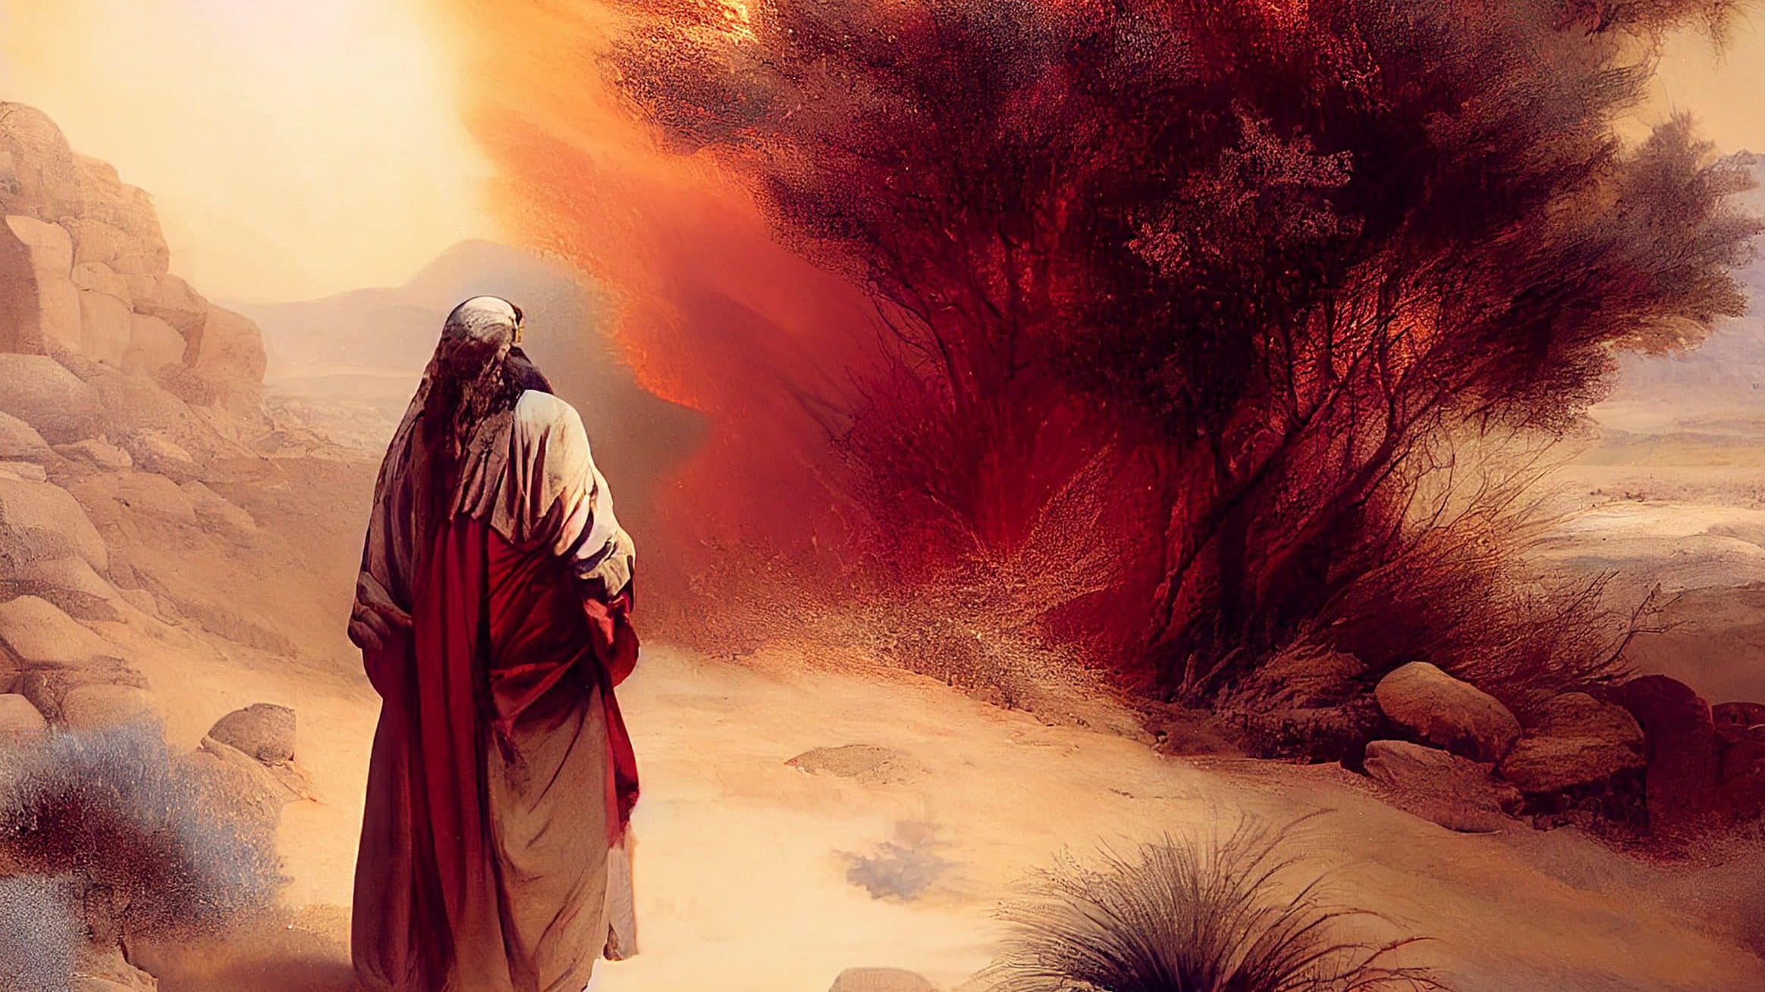
Could God be more obvious?

Slide 20
Could God be more obvious? But how obvious must God be?
Notes:
Exodus 33:20 says that God’s full glory is lethal.

Slide 21
Bill Maher
“…if I thought [God] was speaking to me, I’d check myself into Bellevue [psychiatric hospital], and I think you should too”
Notes:
The problem is that Bertrand Russell and Maher would fancy themselves as guided by the evidence…as rational nonbelievers.

Slide 22
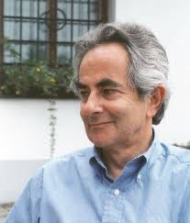
Thomas Nagel
“I speak from experience, being strongly subject to this fear myself: I want atheism to be true and am made uneasy by the fact that some of the most intelligent and well-informed people I know are religious believers.

Slide 23
Thomas Nagel
It isn’t just that I don’t believe in God and, naturally, hope that I’m right in my belief. It’s that I hope there is no God! I don’t want there to be a God; I don’t want the universe to be like that.”
Nagel refers to this as a “cosmic authority problem.”

Slide 24
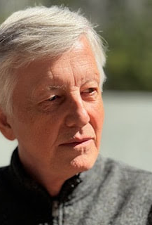
J.L. Schellenberg
“The mere fact that persons can maintain reasonable non-belief in the existence of God suggests the lack of…evidence, and thereby the non-existence of a perfectly loving God.” (Ross Inman’s summary)
Notes:
If an all-loving God existed and created us to be in relationship with Him, then we would expect that He provide the necessary conditions for believing in Him, namely clear and decisive evidence that He is, in fact, there.

Slide 25
J.L. Schellenberg
“The mere fact that persons can maintain reasonable non-belief in the existence of God suggests the lack of…evidence, and thereby the non-existence of a perfectly loving God.” (Ross Inman’s summary)

Slide 26
How Obvious?
Schellenberg: a perfectly loving God should be obvious enough to overcome reasonable non-belief.
Does God want us to believe?
God COULD get us to believe!!

Slide 27
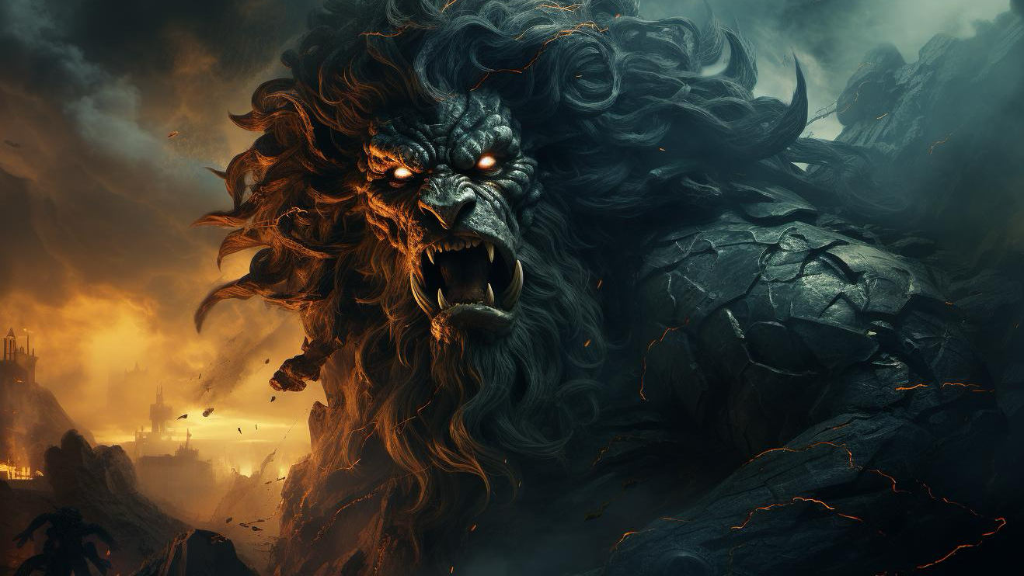
Notes:
Read p. 181 Wandering

Slide 28
Sufficient for what?
Christians should admit that God is not as obvious as he could be.
God could do more of the spectacular.
Atheists should admit that God is not completely hidden either.
There is evidence for God.

Slide 29
Sufficient for what?
Why isn’t God obvious enough to overcome reasonable non-belief?
**Because God doesn’t want us to merely believe**
Many people who believe in God are “functional atheists.”
“Even the demons believe, and they shudder.” (James 2:19)

Slide 30
Sufficient for what?
If God doesn’t want mere belief, what is he after? *A life freely surrendered in faith.
Unbelievers may believe in God if there was greater evidence, but why should we think they would surrender their lives in faith?

Slide 31
Sufficient for what?
It’s possible no amount of evidence would overcome the cosmic authority problem.
God could compel belief, but how could he compel the free surrender of faith?
I suggest that God degree of hiddenness is calibrated for bringing people to faith.

Slide 32
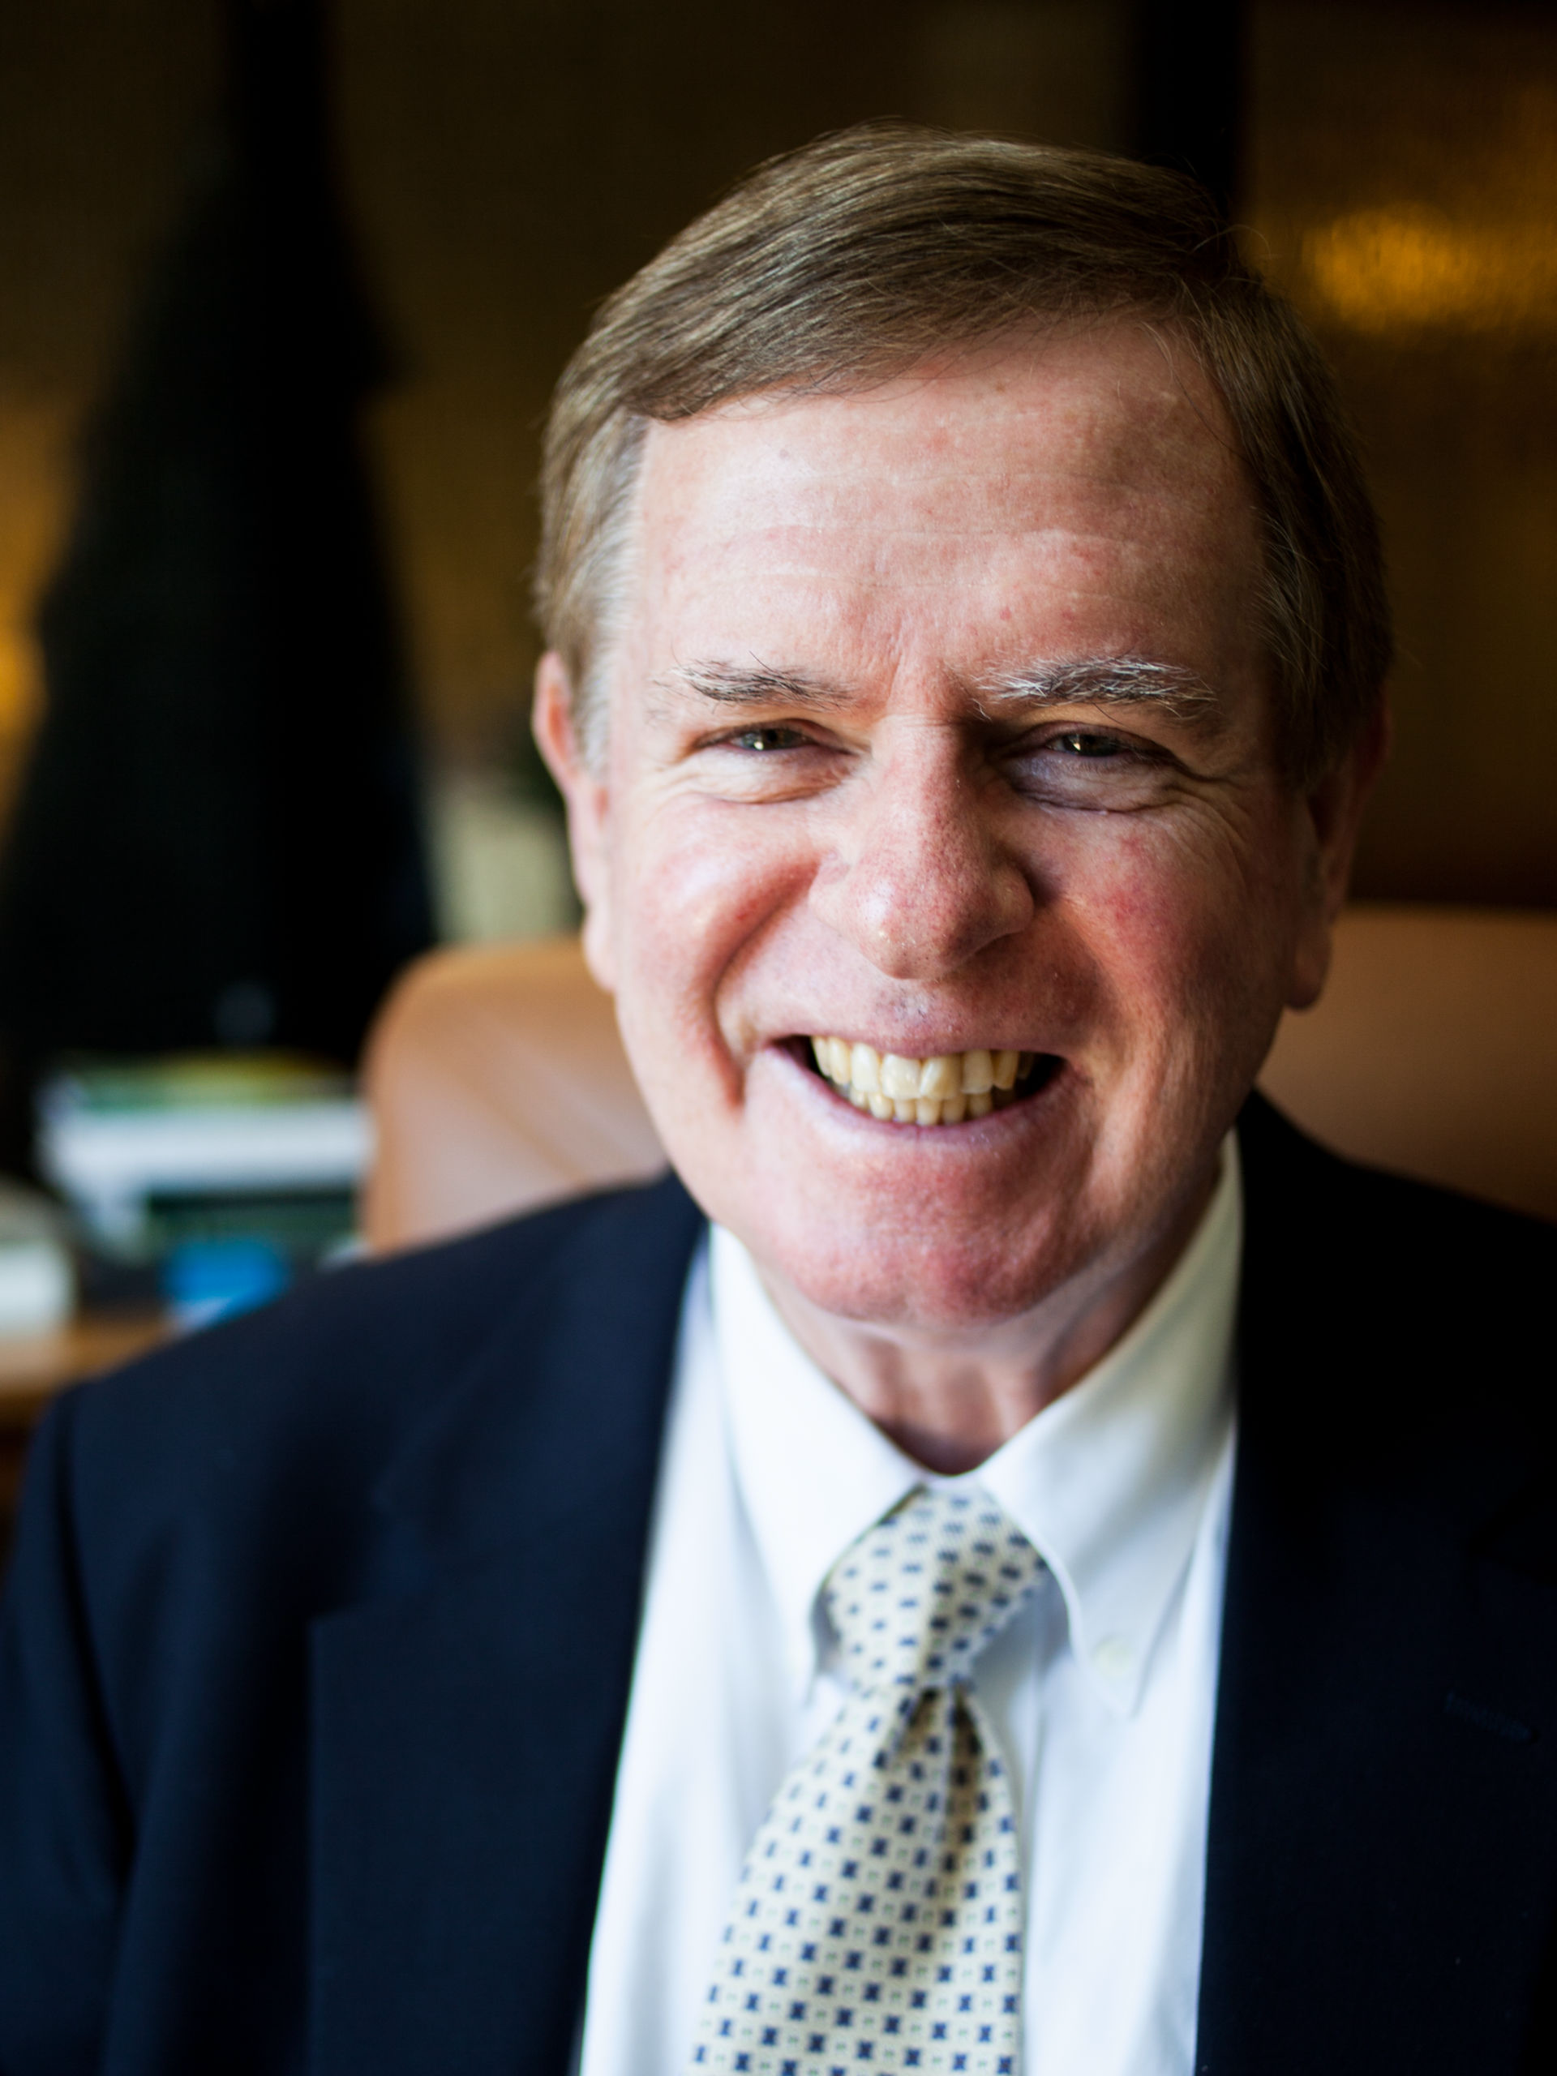
C. Stephen Evans
“The evidence for God is widely available and easily resistible”

Slide 33
Jesus and the Spectacular (Jn. 6)
14: “Surely this is the Prophet who is come into the world”
66: From this time many of his disciples turned back and no longer followed him.
67-68: “You do not want to leave too, do you?” Jesus asked the Twelve. Simon Peter answered him, “Lord, to whom shall we go? You have the words of eternal life. ⁶⁹ We have come to believe and to know that you are the Holy One of God.”

Slide 34
What’s the Problem?
False
If God* exists, he is sufficiently obvious to overcome reasonable non-belief.
But God is not sufficiently obvious to overcome reasonable non-belief.
Therefore, God does not exist.
False
Notes:
*We mean throughout the Christian God. This means all good and all powerful and a God who desires relationship with us.
It is a logically valid argument…and so if we don’t like the conclusion we have to reject one or both of the premises.

Slide 35
What’s the Problem?
If God* exists, he is sufficiently obvious for faith.
But God is not sufficiently obvious for faith.
Therefore, God does not exist.
False
False
Notes:
*We mean throughout the Christian God. This means all good and all powerful and a God who desires relationship with us.
It is a logically valid argument…and so if we don’t like the conclusion we have to reject one or both of the premises.

Slide 36
Notes:
Life is so extraordinary…the evidence of God is sufficiently obvious, but deniable when our hearts are hardened.

